Slide 1

What is React?

Slide 2
Objectives
Overview React
Describe new in React 18
Describe installing required dependencies
Visual Studio Code
Node JS
Chrome DevTools
React Developer Tools
Demo Create React App
Set up a Git

Slide 3
What is React?
https://www.statista.com/statistics/1124699/worldwide-developer-survey-most-used-frameworks-web
React is "A JavaScript library created by Facebook for building user interfaces (UI)” and a tool for building UI components.
It allows developers to create reusable UI components and manage the state of an application efficiently.
Use ways to build dynamic web and mobile applications.
If React isn't a framework, then what is it exactly?
React is just the view layer
Simplicity is good
Declarative UI structures
Data changes over time
Performance matters
The right level of abstraction

Slide 4
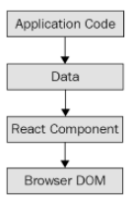
React is just the view layer
React is generally thought of as the view layer in an application.
To render this data to the UI, pass it to a React Component, which handles the job of getting the HTML into the page.

Slide 5
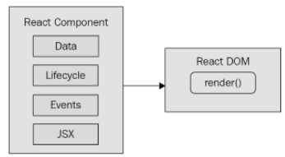
Simplicity is good
React is divided into two major APIs:
The React Component API: These are the parts of the page that are rendered by the React DOM.
React DOM: This is the API that's used to perform the rendering on a web page.
Within a React component, we have the following areas to think about:
Data
Lifecycle
Events
JSX

Slide 6
Declarative UI structures
The syntax used by React components is called JSX (JavaScript XML).
What's groundbreaking about the declarative JSX approach is that we don't have to perform little micro-operations to change the content of a component.
The XML-style syntax makes it easy to describe what the UI should look like – that is, what are the HTML elements that this component is going to render? This is called declarative programming and is very well suited for UI development.

Slide 7
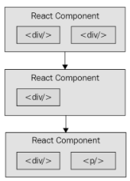
Data changes over time
JSX is like a static string, representing a chunk of rendered output.
React components rely on data being passed into them. This data represents the dynamic parts of the UI – for example, a UI element that's rendered based on a Boolean value could change the next time the component is rendered.
React can handle the performance demands of this approach.

Slide 8
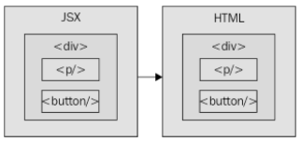
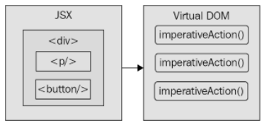
Performance matters
Can declare the structure of the UI with JSX. This is less error-prone than the imperative approach of assembling the UI piece by piece. However, the declarative approach does present a challenge –performance.
The Document Object Model (DOM) represents HTML in the browser after it has been rendered. The DOM API is how JavaScript is able to change content on a page.
Diffing and patching.
How JSX syntax translates to HTML in the browser DOM
React transpiles JSX syntax into imperative DOM API calls
Notes:
Diffing means comparing old content with new content to figure out what's changed. Patching means executing the necessary DOM operations to render the new content.

Slide 9
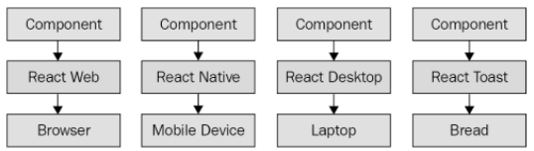
The right level of abstraction
React code is abstraction
From left to right, we have React Web (just plain React), React Native, React Desktop, and React Toast. The same pattern applies:
Implement components specific to the target.
Implement a React renderer that can perform the platform-specific operations under the hood.
React abstracts the target rendering environment from the components that we implement

Slide 10
Key Features of React
Component-Based: React encourages the creation of modular UI components, making code more organized and maintainable.
Virtual DOM: React uses a virtual representation of the DOM, optimizing updates and improving performance.
Large Community: A vast community of developers and libraries support React, offering solutions to various challenges.

Slide 11
What's new in React 18?
Automatic batching
Batching state updates together drastically improves the performance of React applications because it reduces the number of renders to be performed
State transitions
The idea with state transitions is that the less important state updates that take place in application should have lower priority than state updates that should happen immediately.

Slide 12
Installing required dependencies
Visual Studio Code
Open https://code.visualstudio.com in your web browser and click the download link for your operating system
Node.js
Visit the npm Package Repository at https://npmjs.com
Chrome Dev Tools: Open your Chrome browser
React Developer Tools
Go to the Chrome Web Store at https://chrome.google.com/webstore using your Chrome browser

Slide 13
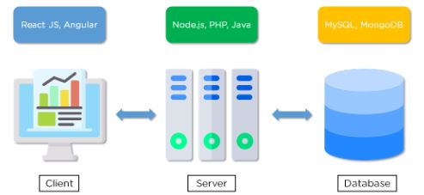
Web Applications
A web application is a program that runs on a server and is rendered by a client browser, using the internet to access all the resources of that application. It usually can be easily broken down into three parts:
Client
Server
Database

Slide 14
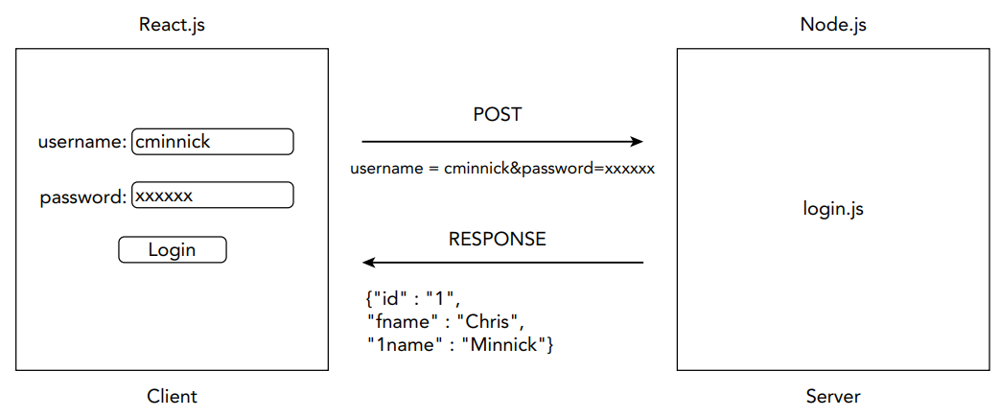
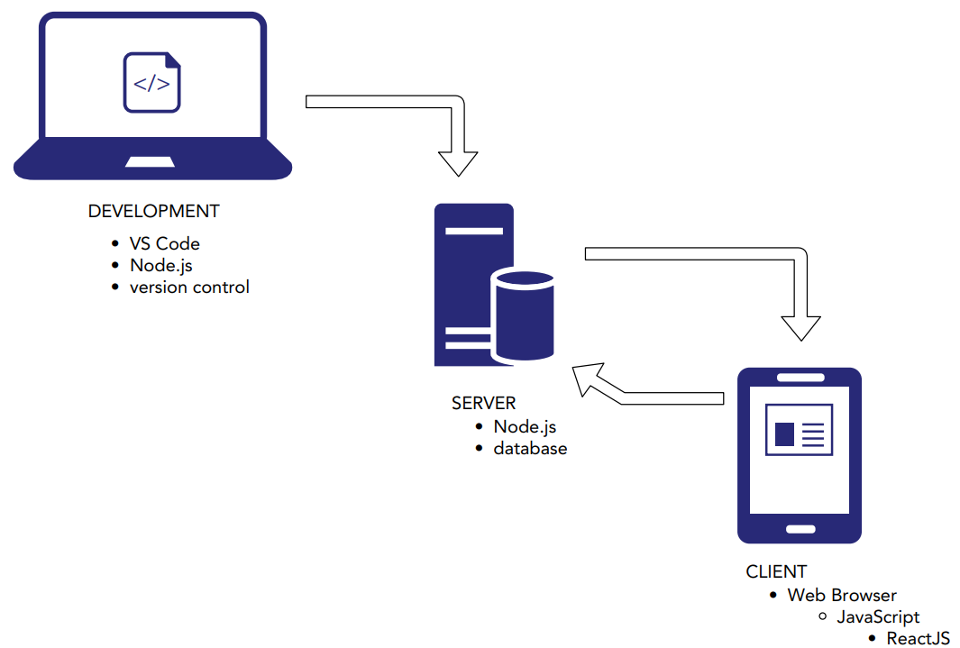
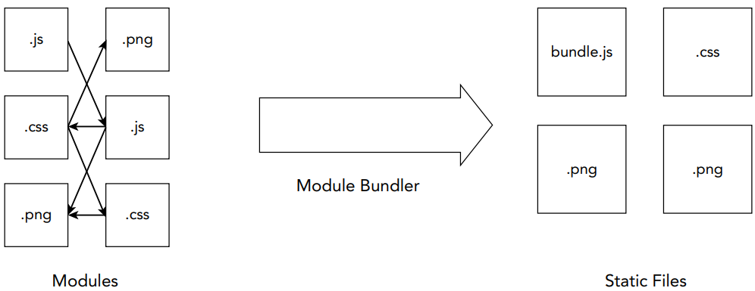
Node.JS
A way to run JavaScript on web servers
Common tasks that take place in development and that can be aided by Node.js include
Minification
Transpiling
Module bundling
Package management
CSS preprocessor
Testing frameworks
Build automation

Slide 15
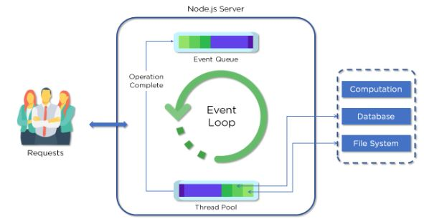
Node Architecture
Parts of the Node.js Architecture:
Requests
Node.js Server
Event Queue
Thread Pool
Event Loop
External Resources
Notes:
Node.js uses the “Single Threaded Event Loop” architecture to handle multiple concurrent clients. Node.js Processing Model is based on the JavaScript event-based model along with the JavaScript callback mechanism.

Slide 16
Node Package Manager
Node package manager (NPM): manages ecosystem of node modules / packages
A package contains:
JS files
package.json (manifest)
npm is the standard package manager for Node.js.

Slide 17
package.json
A package.json file affords you a lot of great things:
It serves as documentation for what packages your project depends on.
It allows you to specify the versions of a package that your project can use using semantic versioning rules.
Makes your build reproducible, which means that its way easier to share with other developers.
Source: https://docs.npmjs.com/getting-started/using-a-package.json

Slide 18
Initializing package.json
To initialize a package.json file for your project, type at the prompt in your project directory:
npm init / npm init -y
If a project has a package.json file, by running
npm install
Can install a specific package by running
npm install <package-name>
Ex: npm i bootstrap@5.3.1
Notes:
it will install everything the project needs, in the node_modules folder, creating it if it's not existing already.

Slide 19
Using npm
As for the optionalDependencies the difference is that build failure of the dependency will not cause installation to fail.
See more flags added to this command:
--save -dev installs and adds the entry to the package.json file devDependencies
--no-save installs but does not add the entry to the package.json file dependencies
--save-optional installs and adds the entry to the package.json file optionalDependencies
--no-optional will prevent optional dependencies from being installed
--save --force attempting to install or update dependencies that may cause conflicts or compatibility issues

Slide 20
Exercise 1: Install Node.js

Slide 21
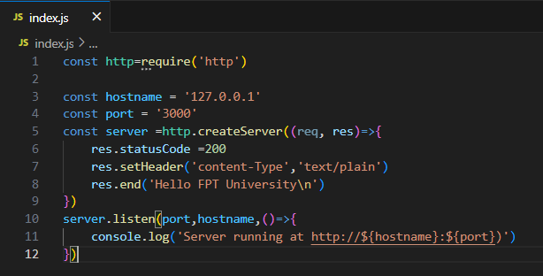
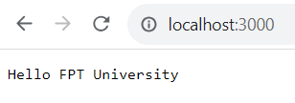

Example Node.js
The most common example Hello FPT University of Node.js is a web server:
Notes:
Npm install & npm start

Slide 22
How much JavaScript to use Node.js?
Lexical Structure
Expressions
Data Types
Classes
Variables
Functions
this operator
Arrow Functions
Loops
Scopes
Arrays
Template Literals
Strict Mode
ECMAScript 2015 (ES6) and beyond
Asynchronous programming and callbacks
Timers
Promises
Async and Await
Closures
The Event Loop

Slide 23
Exercise 2: Demo Create new React App

Slide 24
Demo Create new React App
To create a new React app using Create React App, use the npx command, followed by create-react app, followed by a name that you want to give your new React app. npx create-react-app my-new-app cd my-new-app
Note:
Naming Your React App
Making Your First React App
Notes:
must be less than 214 characters long, can’t start with a dot or underscore, can’t have uppercase letters, can’t contain any characters that aren’t allowed in URLs (such as ampersands and dollar signs) and that are “unsafe” in URLs (such as the percent symbol and spaces).

Slide 25
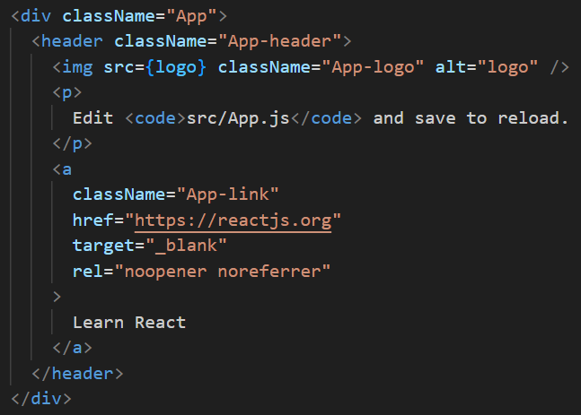
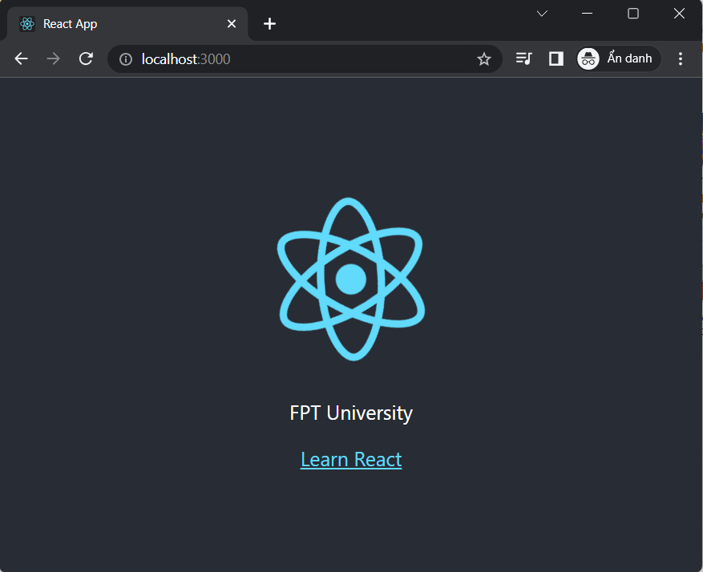
Run React App

Slide 26
Git

Slide 27
Some Basic Concepts
Version Control: software tool(s) that enable the management of changes to source code
Maintaining version history
Several version control tools: CVS, SVN, Git etc.
Distributed version control system
Developed by Linus Torvalds for managing Linux kernel development
Widely adopted now by several projects
The Node ecosystem thrives on it

Slide 28
Git Install
Download Git to your computer at: https://git-scm.com/downloads
Choose the Git version that is suitable for the operating system you are using on your computer and download it.
Open the installation file and run the setup program.
Agree to the terms and continue the installation process.
Choose the installation options that you want to use and continue the installation process.
Complete the installation process and restart your computer if required.
Open Command Prompt or Terminal on your computer and check if Git has been successfully installed by entering the following command:
git --version
If Git has been installed successfully, the version of Git will be displayed on Command Prompt or Terminal.

Slide 29
Online Git Repository
Several online Git repository service providers:
GitHub (https://github.com)
Bitbucket (https://bitbucket.org)

Slide 30
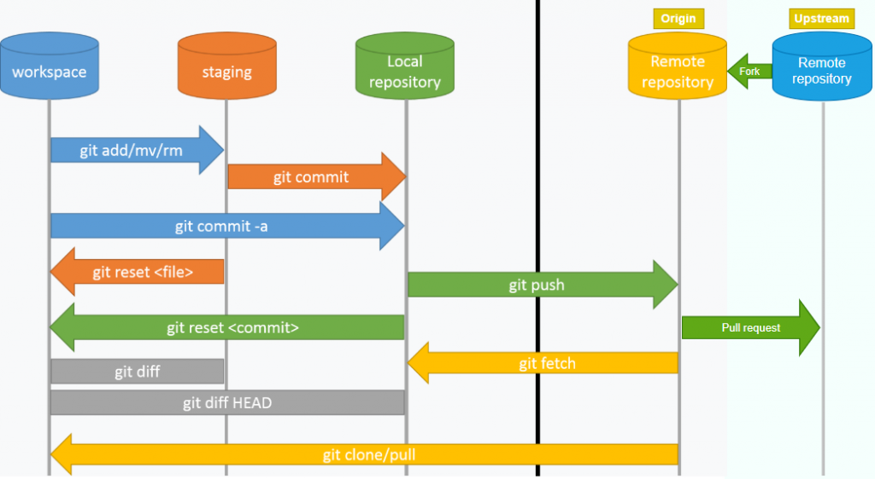
GIT Overview

Slide 31
Config Git
Configure Git git config --global user.name "yourname " git config --global user.email "youremail"
Creating Git Folder cd myproject
Initialize Git git init
Notes:
Note: Use global to set the username and e-mail for every repository on your computer.
If you want to set the username/e-mail for just the current repo, you can remove global
Note: Git now knows that it should watch the folder you initiated it on.
Git creates a hidden folder to keep track of changes.

Slide 32
Using Git
Add the remote online repository git remote add origin <repository URL>
Git Staging Environment git add ‘your file name’ git add --all
Check status git status
Git Commit git commit -m "First of Hello World!"
Git Commit Log git log
New Git Branch git branch ‘hello-world’
Git Checkout git checkout hello-world
Push Changes to GitHub git push -u origin master

Slide 33
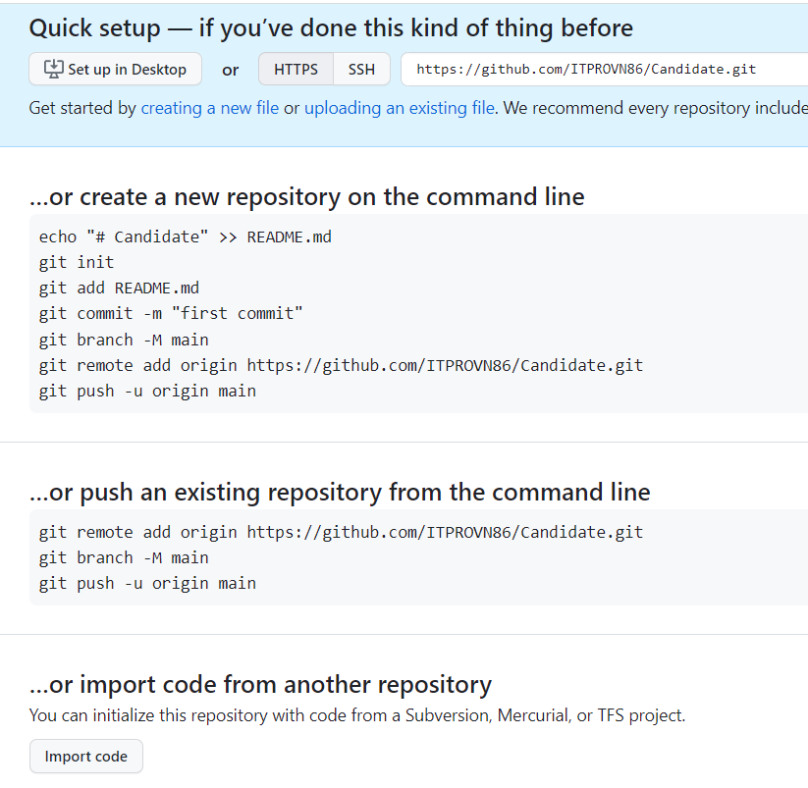
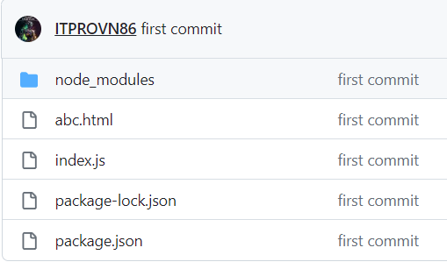
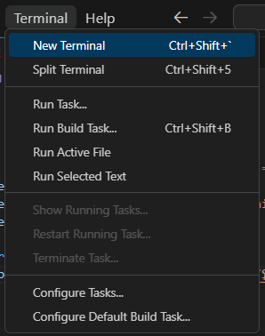
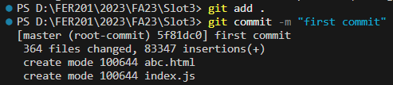
Quick setup with git
2
4
1
3

Slide 34
Exercise 3: Install, Setting up and Push Code to Git

Slide 35
Summary
Concepts were introduced:
Overview React
Describe new in React 18
Describe installing required dependencies
Visual Studio Code
Node JS
Chrome DevTools
React Developer Tools
Demo Create React App
Set up a Git

